Slide 1
Rationale
Aspiring Database Developers should be able to efficiently query and maintain databases.
This module will help students learn the Structured Query Language (SQL) to query and manage databases.

Slide 2
Objectives
In this session, you will learn to:
Appreciate SQL Server as a database server

Slide 3
Introduction to SQL Server
SQL Server:
Is a data engine introduced by Microsoft.
Provides an environment used to create databases.
Allows secure and efficient storage and management of data.
Provides other components and services that support the business intelligence platform to generate reports and help in data analysis.
Notes:
3
Student already have learnt about type 2 SCDs in Module I. Therefore, you can start this topic by asking the following questions to students:
What are type 2 SCDs?
Given an example to explain type 2 SCDs.
This will recapitulate what they have learnt about type 2 SCD in Module 1.
Now explain the strategy to update the data into these dimension tables with help the example given in SG.
After explaining the examples, you can ask students to think of an example of a type 2 SCD and then tell the strategy to update the data into this dimension table.

Slide 4
Role of a Database Server
A business application can have the following elements:
The user interface (UI) or the presentation element, through which data is entered.
The application logic or the business rule element, which helps in validating the entered data.
The data storage or the data management element, which manages the storage and retrieval of data.
Notes:
You can summarize the session by running through the summary given in SG.
In addition, you can also ask students summarize what they have learnt in this session.

Slide 5
Role of a Database Server (Contd.)
Based on preceding three elements, the application architectures can be categorized as:
Single-tier architecture
Two-tier architecture
Three-tier architecture
N-tier architecture
Notes:
You can summarize the session by running through the summary given in SG.
In addition, you can also ask students summarize what they have learnt in this session.

Slide 6
Role of a Database Server (Contd.)
Single-tier architecture:
Combines all the elements of a business application as a single process.
Two-tier architecture:
Divides the business application into two parts, one part handles the data, while the other provides the user interface.
Is also called the client-server architecture.
Notes:
Student already have learnt about type 2 SCDs in Module I. Therefore, you can start this topic by asking the following questions to students:
What are type 2 SCDs?
Given an example to explain type 2 SCDs.
This will recapitulate what they have learnt about type 2 SCD in Module 1.
Now explain the strategy to update the data into these dimension tables with help the example given in SG.
After explaining the examples, you can ask students to think of an example of a type 2 SCD and then tell the strategy to update the data into this dimension table.

Slide 7
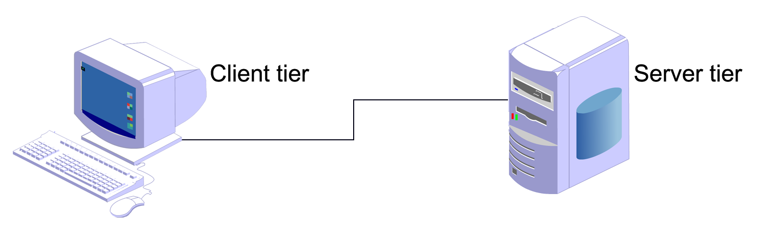
Role of a Database Server (Contd.)
The following figure shows the two-tier architecture.
Handles the UI.
Implements the application logic and validates the input data based on the business rules.
Notes:
Student already have learnt about type 2 SCDs in Module I. Therefore, you can start this topic by asking the following questions to students:
What are type 2 SCDs?
Given an example to explain type 2 SCDs.
This will recapitulate what they have learnt about type 2 SCD in Module 1.
Now explain the strategy to update the data into these dimension tables with help the example given in SG.
After explaining the examples, you can ask students to think of an example of a type 2 SCD and then tell the strategy to update the data into this dimension table.

Slide 8
Role of a Database Server (Contd.)
Three-tier architecture:
It divides the business application into three tiers.
The first tier is called the client tier.
The second or middle tier is called the business tier.
The third tier is called the server tier.
Notes:
Student already have learnt about type 2 SCDs in Module I. Therefore, you can start this topic by asking the following questions to students:
What are type 2 SCDs?
Given an example to explain type 2 SCDs.
This will recapitulate what they have learnt about type 2 SCD in Module 1.
Now explain the strategy to update the data into these dimension tables with help the example given in SG.
After explaining the examples, you can ask students to think of an example of a type 2 SCD and then tell the strategy to update the data into this dimension table.

Slide 9
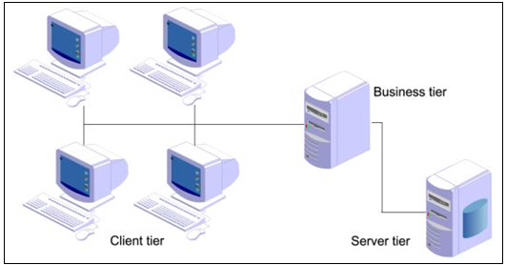
Role of a Database Server (Contd.)
The following figure shows the three-tier architecture.
The business tier consists of all the business rules.
The server tier contains a database server that manages the data.
Notes:
Student already have learnt about type 2 SCDs in Module I. Therefore, you can start this topic by asking the following questions to students:
What are type 2 SCDs?
Given an example to explain type 2 SCDs.
This will recapitulate what they have learnt about type 2 SCD in Module 1.
Now explain the strategy to update the data into these dimension tables with help the example given in SG.
After explaining the examples, you can ask students to think of an example of a type 2 SCD and then tell the strategy to update the data into this dimension table.

Slide 10
Role of a Database Server (Contd.)
N-tier architecture:
Is also called as multi-tier architecture.
Has one component near the client tier, which is responsible to do the client side validation and send the data to the presentation tier.
Notes:
Student already have learnt about type 2 SCDs in Module I. Therefore, you can start this topic by asking the following questions to students:
What are type 2 SCDs?
Given an example to explain type 2 SCDs.
This will recapitulate what they have learnt about type 2 SCD in Module 1.
Now explain the strategy to update the data into these dimension tables with help the example given in SG.
After explaining the examples, you can ask students to think of an example of a type 2 SCD and then tell the strategy to update the data into this dimension table.

Slide 11
Role of a Database Server (Contd.)
The n-tier architecture consists of the following layers:
Client tier
UI-centric processing components
Data-centric processing objects
Database server
Notes:
Student already have learnt about type 2 SCDs in Module I. Therefore, you can start this topic by asking the following questions to students:
What are type 2 SCDs?
Given an example to explain type 2 SCDs.
This will recapitulate what they have learnt about type 2 SCD in Module 1.
Now explain the strategy to update the data into these dimension tables with help the example given in SG.
After explaining the examples, you can ask students to think of an example of a type 2 SCD and then tell the strategy to update the data into this dimension table.

Slide 12
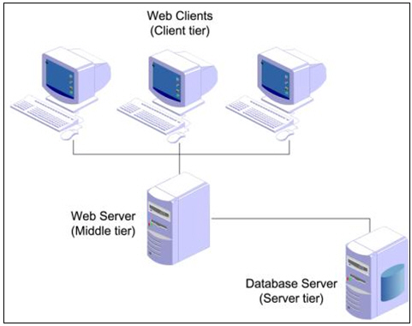
Role of a Database Server (Contd.)
The following figure shows the architecture of the Web applications.
The clients make requests to and receive responses from the Web server.
The Web server transfers the request for data to a database server.
Notes:
Student already have learnt about type 2 SCDs in Module I. Therefore, you can start this topic by asking the following questions to students:
What are type 2 SCDs?
Given an example to explain type 2 SCDs.
This will recapitulate what they have learnt about type 2 SCD in Module 1.
Now explain the strategy to update the data into these dimension tables with help the example given in SG.
After explaining the examples, you can ask students to think of an example of a type 2 SCD and then tell the strategy to update the data into this dimension table.

Slide 13
SQL Server Components
What are the components of SQL Server?

Slide 14
SQL Server Components (Contd.)
The following figure displays the components of SQL Server.
Database Engine
Service Broker
Replication
Full-Text Search
Notification Services
Integration Services
Analysis Services
Reporting Services
Notes:
Explain the components of SQL Server as follows:
Database Engine: Provides support to store, query, process, and secure data on the database server
Integration Services: Allow you to gather and integrate data from various disparate data sources available in an organization
Analysis Services: Help in data analysis in a business intelligence application
Reporting Services: Provide support to generate comprehensive reports on data in database engine or in data warehouse

Slide 15
SQL Server Components (Contd.)
Database engine:
Provides support to store, query, process, and secure data on the database server.
Allows you to create and manage database objects, such as tables.
Provides the following background services:
Service broker
Replication
Full-text search
Notification services
Notes:
15
Student already have learnt about type 2 SCDs in Module I. Therefore, you can start this topic by asking the following questions to students:
What are type 2 SCDs?
Given an example to explain type 2 SCDs.
This will recapitulate what they have learnt about type 2 SCD in Module 1.
Now explain the strategy to update the data into these dimension tables with help the example given in SG.
After explaining the examples, you can ask students to think of an example of a type 2 SCD and then tell the strategy to update the data into this dimension table.

Slide 16
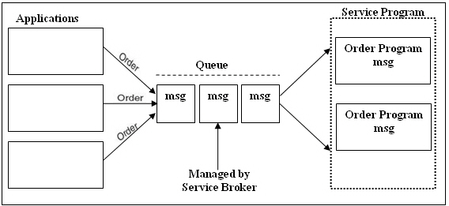
SQL Server Components (Contd.)
Service Broker:
Provides support for asynchronous communication between clients and the database server.
Enables reliable query processing.
The following figure shows an example of order processing system.
Notes:
16
Student already have learnt about type 2 SCDs in Module I. Therefore, you can start this topic by asking the following questions to students:
What are type 2 SCDs?
Given an example to explain type 2 SCDs.
This will recapitulate what they have learnt about type 2 SCD in Module 1.
Now explain the strategy to update the data into these dimension tables with help the example given in SG.
After explaining the examples, you can ask students to think of an example of a type 2 SCD and then tell the strategy to update the data into this dimension table.

Slide 17
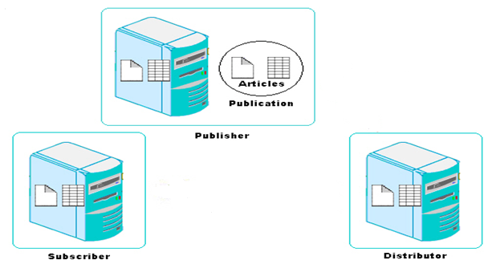
SQL Server Components (Contd.)
Replication:
Allows you to copy and distribute data and database objects from one database server to another.
The following figure shows an example of order processing system.
Copies data to the distributor.
Distributes data to the subscriber.
Notes:
17
Student already have learnt about type 2 SCDs in Module I. Therefore, you can start this topic by asking the following questions to students:
What are type 2 SCDs?
Given an example to explain type 2 SCDs.
This will recapitulate what they have learnt about type 2 SCD in Module 1.
Now explain the strategy to update the data into these dimension tables with help the example given in SG.
After explaining the examples, you can ask students to think of an example of a type 2 SCD and then tell the strategy to update the data into this dimension table.

Slide 18
SQL Server Components (Contd.)
Full-text search:
Allows you to implement fast and intelligent search in large databases.
Notification services:
Allow you to generate and send notification messages to the users or administrators about any event.
Allow developers to build notification applications that send timely, personalized information updates, helping to enhance customer relationships.
Notes:
18
Student already have learnt about type 2 SCDs in Module I. Therefore, you can start this topic by asking the following questions to students:
What are type 2 SCDs?
Given an example to explain type 2 SCDs.
This will recapitulate what they have learnt about type 2 SCD in Module 1.
Now explain the strategy to update the data into these dimension tables with help the example given in SG.
After explaining the examples, you can ask students to think of an example of a type 2 SCD and then tell the strategy to update the data into this dimension table.

Slide 19
SQL Server Components (Contd.)
Integration services:
These services allow you to gather and integrate the varied data in a consistent format in a common database called the data warehouse.
A data warehouse is similar to a physical warehouse that stores raw material or products for further distribution.
The SQL Server Integration Services (SSIS) Import and Export Wizard helps you to complete the process of selecting the data source, the destination, and the objects that will be transferred to create a data warehouse.
Notes:
19
Student already have learnt about type 2 SCDs in Module I. Therefore, you can start this topic by asking the following questions to students:
What are type 2 SCDs?
Given an example to explain type 2 SCDs.
This will recapitulate what they have learnt about type 2 SCD in Module 1.
Now explain the strategy to update the data into these dimension tables with help the example given in SG.
After explaining the examples, you can ask students to think of an example of a type 2 SCD and then tell the strategy to update the data into this dimension table.

Slide 20
SQL Server Components (Contd.)
Analysis services:
These services help in data analysis in a BI application.
Microsoft SQL Server Analysis Services (SSAS):
Provides Online Analytical Processing (OLAP) for BI applications.
Notes:
20
Student already have learnt about type 2 SCDs in Module I. Therefore, you can start this topic by asking the following questions to students:
What are type 2 SCDs?
Given an example to explain type 2 SCDs.
This will recapitulate what they have learnt about type 2 SCD in Module 1.
Now explain the strategy to update the data into these dimension tables with help the example given in SG.
After explaining the examples, you can ask students to think of an example of a type 2 SCD and then tell the strategy to update the data into this dimension table.

Slide 21
SQL Server Components (Contd.)
Reporting services:
These services provide support to generate complete reports on data in the database engine or in the data warehouse.
These services provide secure and restricted access to these reports.
Microsoft SQL Server Reporting Services (SSRS):
Helps in creating Web-based reports that is based on the content stored in a variety of data sources.
Notes:
21
Student already have learnt about type 2 SCDs in Module I. Therefore, you can start this topic by asking the following questions to students:
What are type 2 SCDs?
Given an example to explain type 2 SCDs.
This will recapitulate what they have learnt about type 2 SCD in Module 1.
Now explain the strategy to update the data into these dimension tables with help the example given in SG.
After explaining the examples, you can ask students to think of an example of a type 2 SCD and then tell the strategy to update the data into this dimension table.

Slide 22
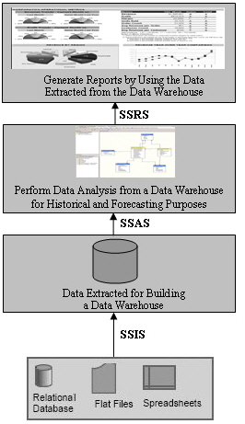
SQL Server Components (Contd.)
The following figure shows the usage of the various SQL Server core components in a BI application.
Notes:
22
Student already have learnt about type 2 SCDs in Module I. Therefore, you can start this topic by asking the following questions to students:
What are type 2 SCDs?
Given an example to explain type 2 SCDs.
This will recapitulate what they have learnt about type 2 SCD in Module 1.
Now explain the strategy to update the data into these dimension tables with help the example given in SG.
After explaining the examples, you can ask students to think of an example of a type 2 SCD and then tell the strategy to update the data into this dimension table.

Slide 23
SQL Server Integration with the .NET Framework
Microsoft SQL Server is integrated with the .NET Framework.
Notes:
23
Student already have learnt about type 2 SCDs in Module I. Therefore, you can start this topic by asking the following questions to students:
What are type 2 SCDs?
Given an example to explain type 2 SCDs.
This will recapitulate what they have learnt about type 2 SCD in Module 1.
Now explain the strategy to update the data into these dimension tables with help the example given in SG.
After explaining the examples, you can ask students to think of an example of a type 2 SCD and then tell the strategy to update the data into this dimension table.

Slide 24
SQL Server Integration with the .NET Framework (Contd.)
The following figure shows the integration of SQL Server with the .NET Framework.
.NET Framework
Database Engine
Service Broker
Replication
Full-Text Search
Notification Services
Integration Services
Analysis Services
Reporting Services
Notes:
You can summarize the session by running through the summary given in SG.
In addition, you can also ask students summarize what they have learnt in this session.

Slide 25
SQL Server Integration with the .NET Framework (Contd.)
The .NET Framework:
Is an environment used to build, deploy, and run business applications.
Has its own collection of services and classes.
Consists of the following components:
Development tools and languages
Base class library
Common Language Runtime (CLR)
Notes:
You can summarize the session by running through the summary given in SG.
In addition, you can also ask students summarize what they have learnt in this session.

Slide 26
SQL Server Integration with the .NET Framework (Contd.)
Development tools and languages:
Are used to create the interface for the Windows forms, Web forms, and console applications.
Base class library:
Provides classes that can be used in the code to accomplish a range of common programming tasks, such as:
String management
Data collection
Database connectivity
File access
Notes:
You can summarize the session by running through the summary given in SG.
In addition, you can also ask students summarize what they have learnt in this session.

Slide 27
SQL Server Integration with the .NET Framework (Contd.)
CLR:
Provides an environment for the application to run.
Provides the following features:
Automatic memory management
Standard type system
Language interoperability
Platform independence
Security management
Notes:
You can summarize the session by running through the summary given in SG.
In addition, you can also ask students summarize what they have learnt in this session.

Slide 28
Features of SQL Server
SQL Server provides the following features:
Built-in support for Extensible Markup Language (XML) data
CLR integration
Scalability
Service-oriented architecture
Support for Web services
High level of security
High availability
Support for data migration and analysis
Intellisense
Policy-based management
Resource governor

Slide 29
SQL
Is the core language used to store, access, and modify data.
Can be categorized as:
Data Definition Language (DDL):
Is used to define the database, data types, structures, and constraints on the data.
Data Manipulation Language (DML):
Is used to manipulate the data in the database objects.
Data Control Language (DCL):
Is used to control the data access in the database.
Data Query Language (DQL):
Is used to query data from the database objects.
Notes:
Emphasize on the fact that most DBMS have created customized versions of the SQL language. For example, Transact-SQL (T-SQL) is a scripting language used on the SQL Server for programming. Alternatively, PL-SQL is used for programming in Oracle. T-SQL confirms to the ANSI SQL-92 standard published by ANSI and ISO in the year 1992.

Slide 30
SQL (Contd.)
Some of the DDL statements are:
CREATE
ALTER
DROP
Some of the DML statements are:
INSERT
UPDATE
DELETE
Some of the DCL statements are:
GRANT
REVOKE
Notes:
Emphasize on the fact that most DBMS have created customized versions of the SQL language. For example, Transact-SQL (T-SQL) is a scripting language used on the SQL Server for programming. Alternatively, PL-SQL is used for programming in Oracle. T-SQL confirms to the ANSI SQL-92 standard published by ANSI and ISO in the year 1992.

Slide 31
Just a minute
Which of the following features of SQL Server allows the developers to implement their programming logic in any language supported by the .NET Framework?
Support for data migration
High availability
CLR integration
Scalability
Answer:
3. CLR integration

Slide 32
Summary
In this session, you learned that:
A business application can have three elements: user interface, business logic, and data storage.
A database server is used to store and manage the database in a business application.
SQL Server consists of the four core components: database engine, integration services, analysis services, and reporting services.
The database engine provides support to store, query, process, and secure data on a database server.
Integration services allow you to gather and integrate this varied data in a consistent format in a common database called the data warehouse.
Analysis services assist in determining past trends and formulating future business decisions.
Notes:
You can summarize the session by running through the summary given in SG.
In addition, you can also ask students summarize what they have learnt in this session.

Slide 33
Summary (Contd.)
Reporting services provide support to generate comprehensive reports on the data stored in the database engine or the data warehouse.
Microsoft SQL Server is integrated with the .NET Framework.
The .NET Framework is an environment used to build, deploy, and run business applications.
The .NET Framework consists of three components: development tools and languages, base class library, and CLR.
Notes:
You can summarize the session by running through the summary given in SG.
In addition, you can also ask students summarize what they have learnt in this session.

Slide 34
Summary (Contd.)
SQL Server provides the following benefits:
Built-in support for XML data
CLR integration
Scalability
Service-oriented architecture
Support for Web services
High level of security
High availability
Support for data migration and analysis
Intellisense
Policy-based management
Resource governor
Notes:
You can summarize the session by running through the summary given in SG.
In addition, you can also ask students summarize what they have learnt in this session.

Slide 35
Summary (Contd.)
SQL includes:
DDL: To create and manage database objects.
DML: To store and manage data in database objects.
DCL: To allow or deny access to database objects.
DQL: To query data from the database objects.
Notes:
You can summarize the session by running through the summary given in SG.
In addition, you can also ask students summarize what they have learnt in this session.

